Slide 1
STRESS IN COMPOSITE BARS
Covering Contents:
Stress in composite bars made up of two different materials
Stresses due to Change in Temperature -Thermal Stresses
Linear and Lateral Strain
Poisson's Ratio
Volumetric Strain
Bulk Modulus
Impact Stress
Resilience

Slide 2
STRESS IN COMPOSITE BARS
A composite bar may be defined as a bar made up of two or more different materials, joined together, in such a manner that the system extends or contracts as one unit, equally, when subjected to tension or compression.

Slide 3
In case of composite bars, the following points should be kept in view:
The extension or contraction of the bar being equal, the strain i.e. deformation per unit length is also equal.
2. The total external load on the bar is equal to the sum of the loads carried by different materials.

Slide 4
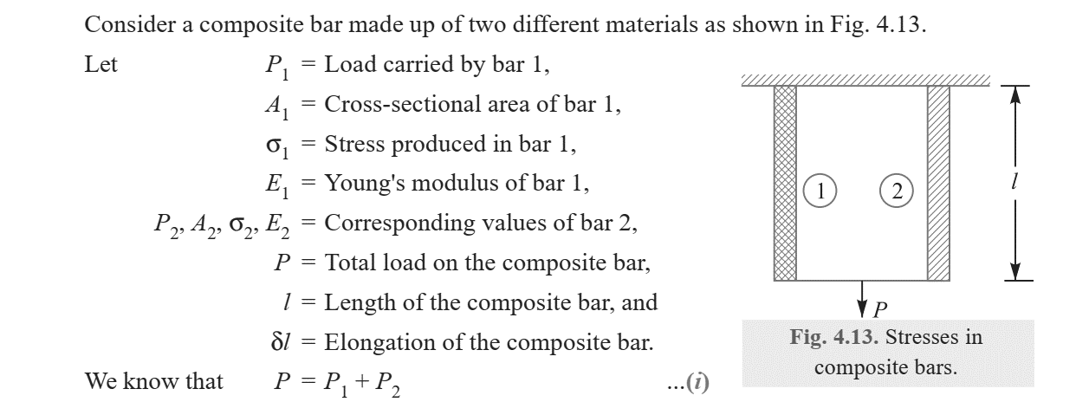

Slide 5
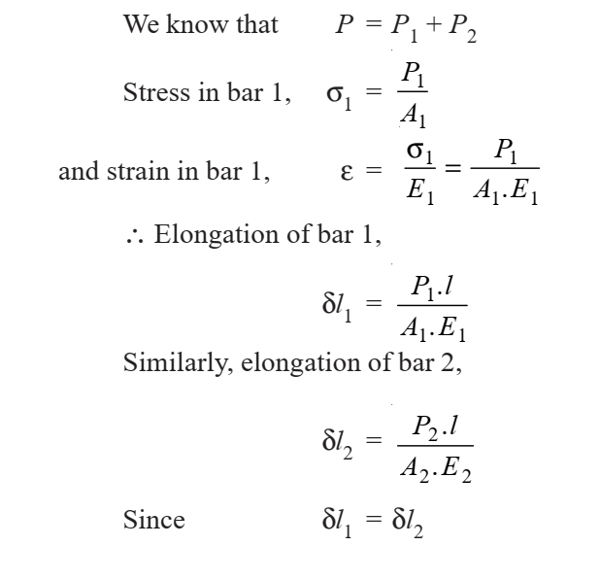

Slide 6
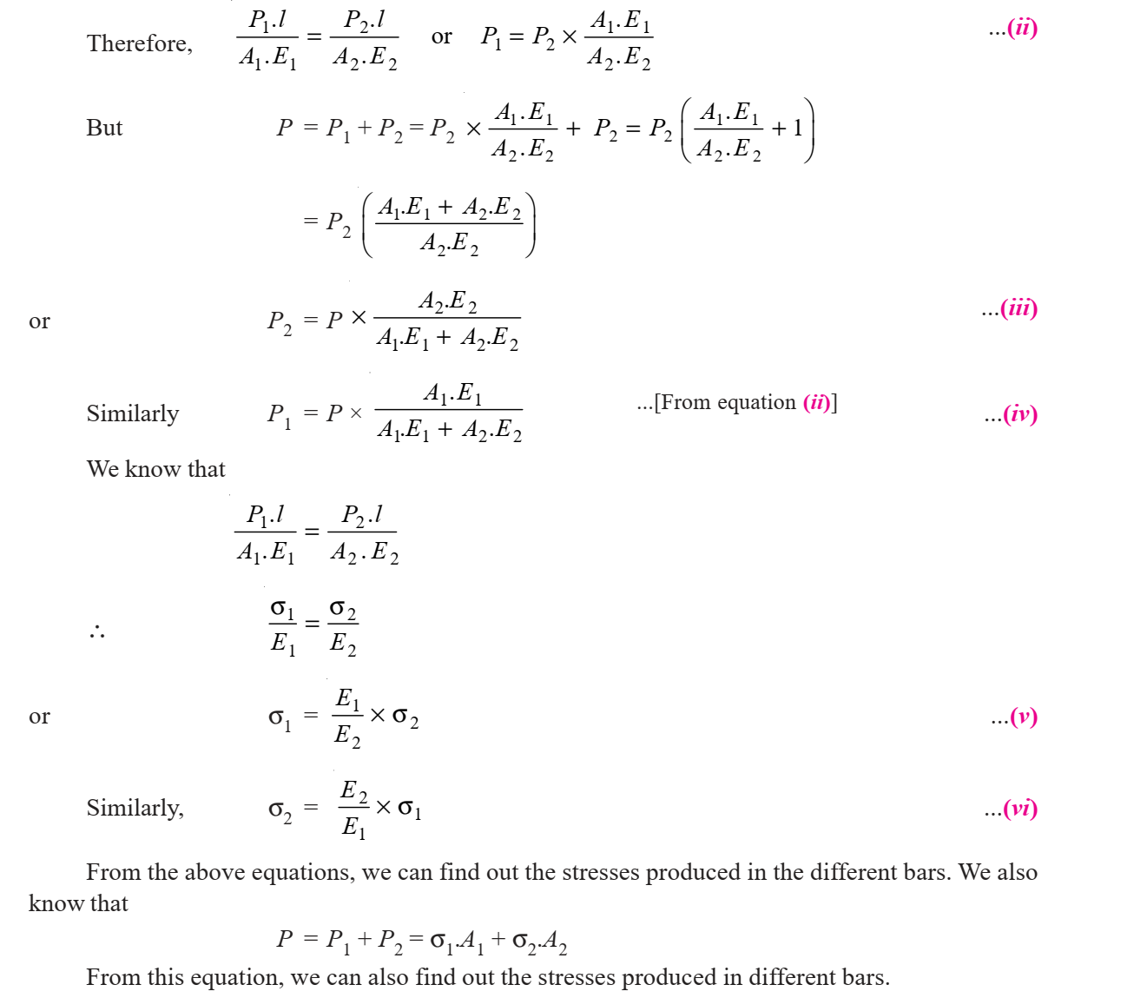

Slide 7
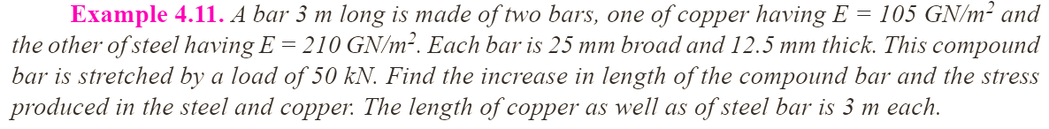

Slide 8
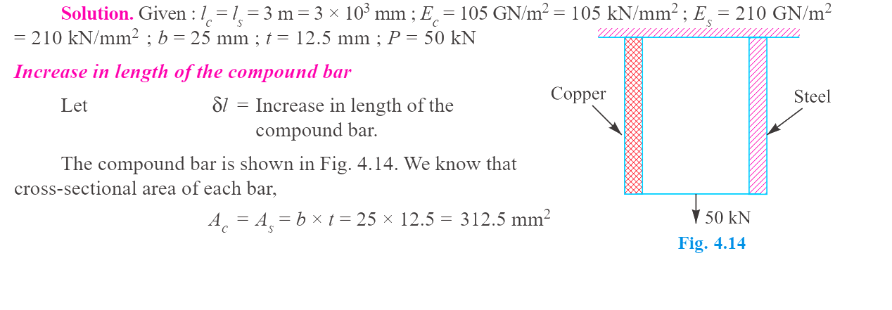

Slide 9
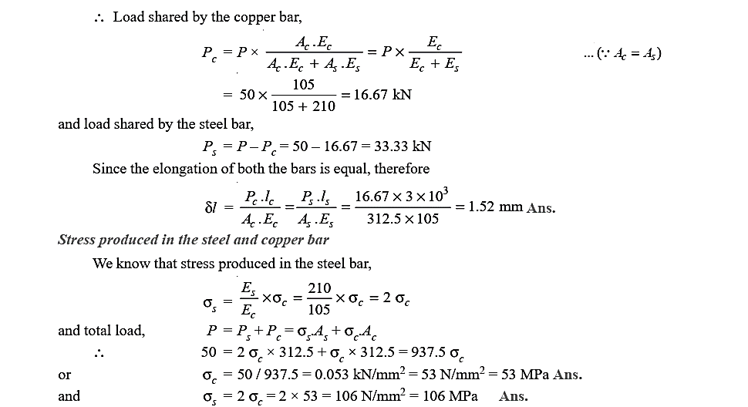

Slide 10
Stresses due to Change in Temperature -Thermal Stresses
Whenever there is some increase or decrease in the temperature of a body, it causes the body to expand or contract. A little consideration will show that if the body is allowed to expand or contract freely, with the rise or fall of the temperature, no stresses are induced in the body. But, if the deformation of the body is prevented, some stresses are induced in the body. Such stresses are known as thermal stresses.

Slide 11
Notes :
1. When a body is composed of two or different materials having different coefficient of thermal expansions, then due to the rise in temperature, the material with higher coefficient of thermal expansion will be subjected to compressive stress whereas the material with low coefficient of expansion will be subjected to tensile stress.

Slide 12
2. When a thin tyre is shrunk on to a wheel of diameter D, its internal diameter d is a little less than the wheel diameter. When the tyre is heated, its circumference π d will increase to π D. In this condition, it is slipped on to the wheel. When it cools, it wants to return to its original circumference π d, but the wheel if it is assumed to be rigid, prevents it from doing so.

Slide 13
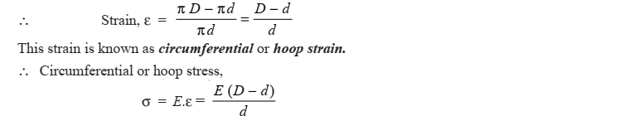
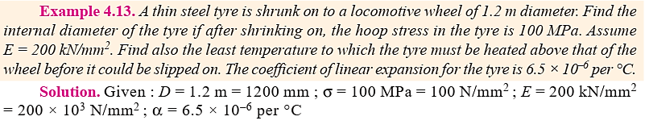

Slide 14
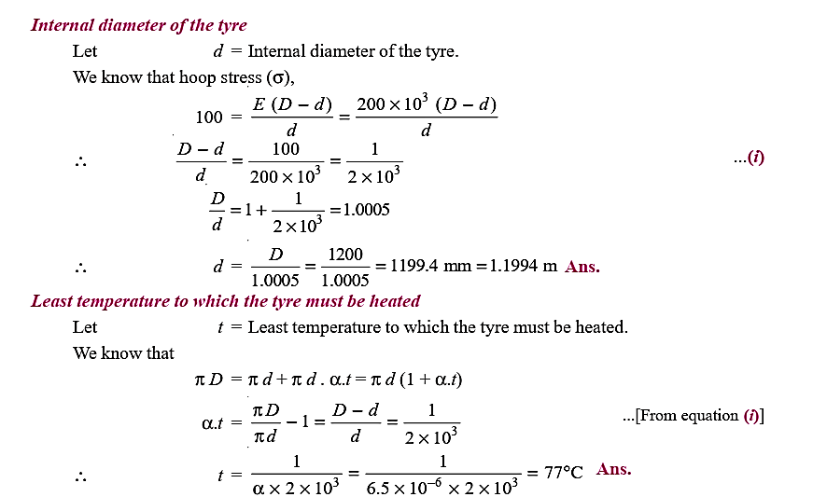

Slide 15
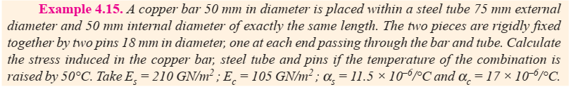
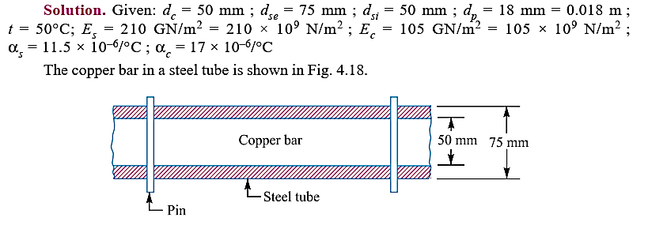

Slide 16
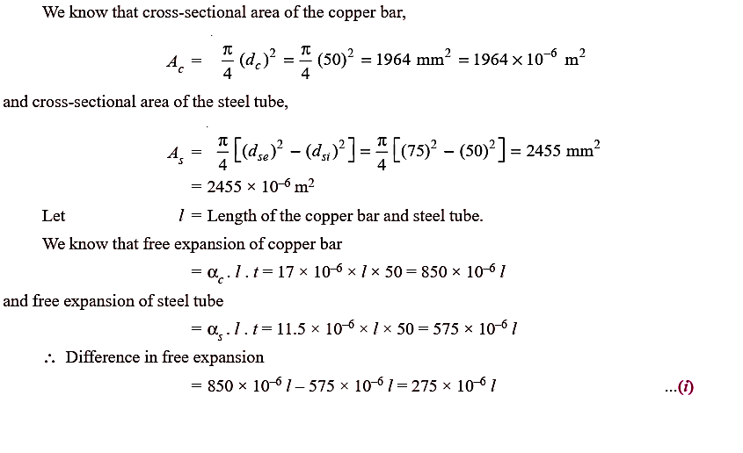

Slide 17
Note that;
Since the free expansion of the copper bar is more than the free expansion of the steel tube, therefore the copper bar is subjected to a *compressive stress, while the steel tube is subjected to a tensile stress.
Let a compressive force P newton on the copper bar opposes the extra expansion of the copper bar and an equal tensile force P on the steel tube pulls the steel tube so that the net effect of reduction in length of copper bar and the increase in length of steel tube equalises the difference in free expansion of the two.

Slide 18

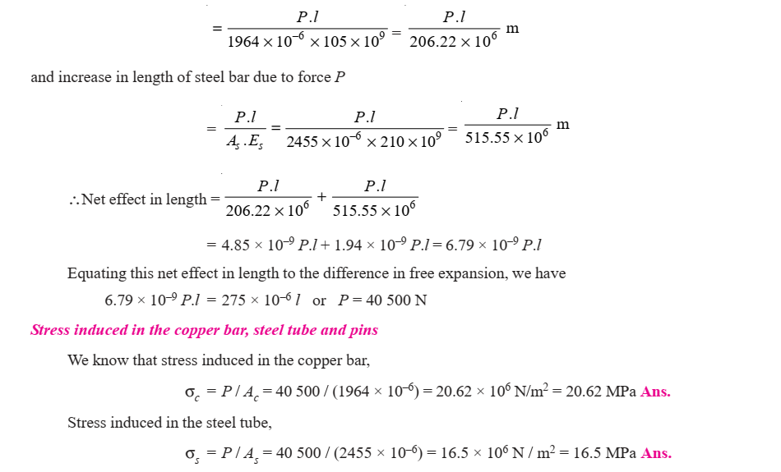
∴ Reduction in length of copper bar due to force P is given by:

Slide 19
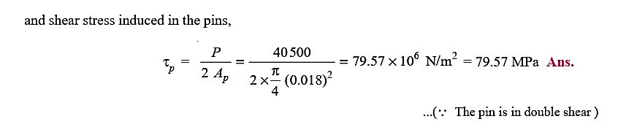
In other words, we can also say that since the coefficient of thermal expansion for copper (αc) is more than the coefficient of thermal expansion for steel (αs), therefore the copper bar will be subjected to compressive stress and the steel tube will be subjected to tensile stress.

Slide 20
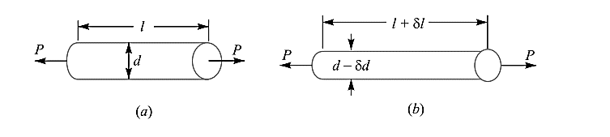
Linear and Lateral Strain
Consider a circular bar of diameter d and length l, subjected to a tensile force P as shown in Fig. 4.19 (a)
A little consideration will show that due to tensile force, the length of the bar increases by an amount δl and the diameter decreases by an amount δd, as shown in Fig. 4.19 (b). Similarly, if the bar is subjected to a compressive force, the length of bar will decrease which will be followed by increase in diameter.

Slide 21
It is thus obvious, that every direct stress is accompanied by a strain in its own direction which is known as linear strain and an opposite kind of strain in every direction, at right angles to it, is known as lateral strain.

Slide 22

Poisson's Ratio
It has been found experimentally that when a body is stressed within elastic limit, the lateral strain bears a constant ratio to the linear strain, Mathematically,
This constant is known as Poisson's ratio and is denoted by 1/m or μ.
Following are the values of Poisson's ratio for some of the materials commonly used in engineering practice.

Slide 23
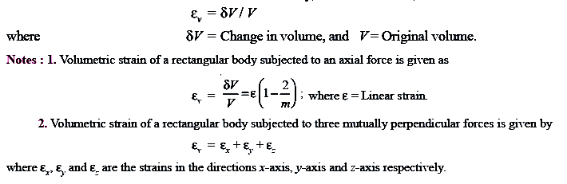
Volumetric Strain
When a body is subjected to a system of forces, it undergoes some changes in its dimensions. In other words, the volume of the body is changed. The ratio of the change in volume to the original volume is known as volumetric strain. Mathematically, volumetric strain,

Slide 24


Bulk Modulus
When a body is subjected to three mutually perpendicular stresses, of equal intensity, then the ratio of the direct stress to the corresponding volumetric strain is known as bulk modulus. It is usually denoted by K. Mathematically, bulk modulus,
Relation Between Bulk Modulus and Young’s Modulus
The bulk modulus (K) and Young's modulus (E) are related by the following relation,

Slide 25

Relation Between Young’s Modulus and Modulus of Rigidity
The Young's modulus (E) and modulus of rigidity (G) are related by the following relation,

Slide 26
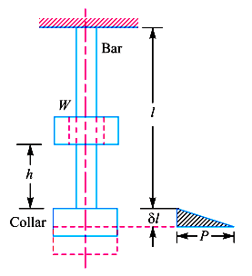
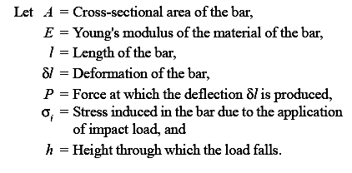
Impact Stress
Sometimes, machine members are subjected to the load with impact. The stress produced in the member due to the falling load is known as impact stress.
Consider a bar carrying a load W at a height h and falling on the collar provided at the lower end, as shown in Fig.

Slide 27
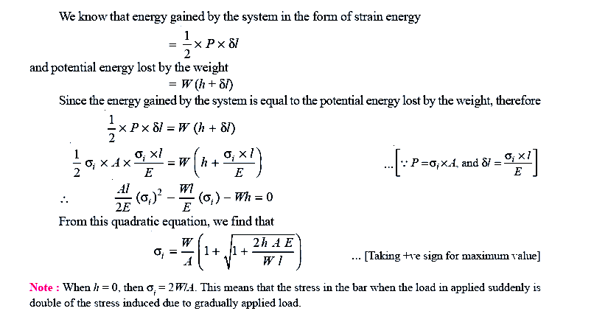

Slide 28

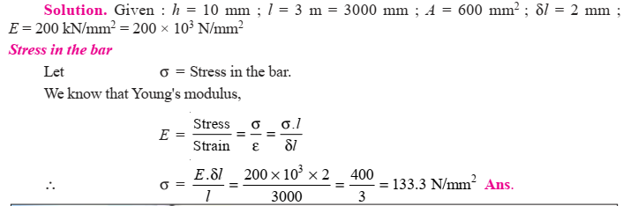

Slide 29
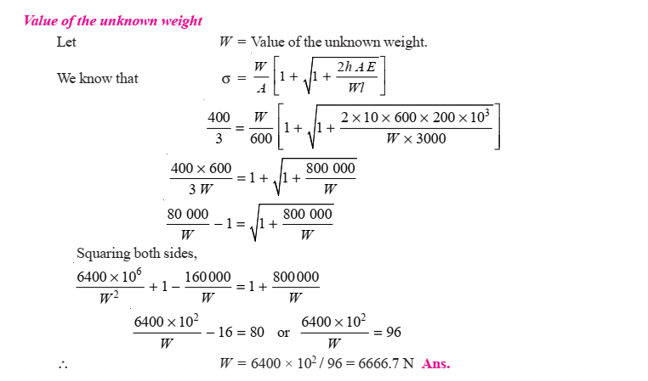

Slide 30
Resilience
When a body is loaded within elastic limit, it changes its dimensions and on the removal of the load, it regains its original dimensions.
So long as it remains loaded, it has stored energy in itself.
On removing the load, the energy stored is given off as in the case of a spring.
This energy, which is absorbed in a body when strained within elastic limit, is known as strain energy. The strain energy is always capable of doing some work.

Slide 31


The strain energy stored in a body due to external loading, within elastic limit, is known as resilience and the maximum energy which can be stored in a body up to the elastic limit is called proof resilience.
The proof resilience per unit volume of a material is known as modulus of resilience.
It is an important property of a material and gives capacity of the material to bear impact or shocks.
Mathematically, strain energy stored in a body due to tensile or compressive load or resilience is given by the formula:
and

Slide 32
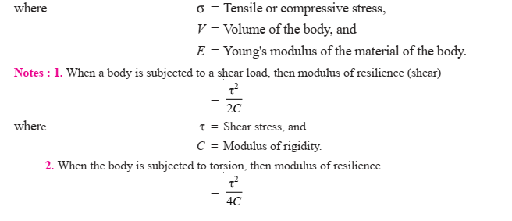

Slide 33
